Slide 1
Introduction to HTML

Slide 2
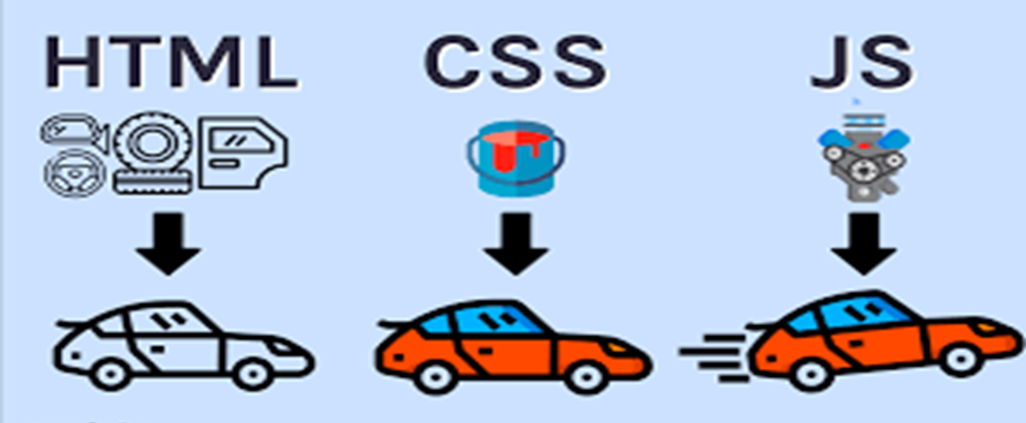
Use of HTML, CSS and JS

Slide 3
What is HTML:
HTML (Hypertext Markup Language) is the standard markup language used for creating web pages.
It is the backbone of every webpage, providing the structure and content of the page.
HTML uses a series of elements and tags to define the different parts of a webpage.
Elements are enclosed in opening and closing tags, and they represent specific types of content or functionality.

Slide 4
HTML Tags and Elements
HTML tags are like keywords which defines that how web browser will format and display the content.
HTML elements are represented by opening and closing tags.
Eg. <h1> => Tag
<h1> This is a heading </h1> => Element.
The opening tag marks the beginning of an element, while the closing tag marks its end.
In HTML we also have self closing tags which don’t require a closing tag. Eg. <br>, <hr>.

Slide 5
HTML Document Structure:
<!DOCTYPE html> //tells browser we are using HTML5
<html lang="en"> //root of an html document
<head> //container for metadata.
<title>Document</title> //page title
</head>
<body> //contains data which is to be displayed on web page
<p> Hello</p>
</body>
</html>

Slide 6
DOCTYPE Declaration
The DOCTYPE declaration is an important element in an HTML document.
It specifies the version of HTML being used in the document.
The DOCTYPE declaration is placed at the very beginning of the HTML document, before the <html> tag.
It ensures that the browser renders the document correctly according to the specified HTML version.

Slide 7
Heading Tag:
Headings are essential for structuring content and providing a hierarchical organization in HTML documents.
HTML offers six levels of headings, ranging from <h1> to <h6>.
Each heading level represents a different level of importance and hierarchy.

Slide 8
Paragraph
<p> tag is used to represent a paragraph of text.
It is used to enclose blocks of text, making it easier to read and comprehend.
Eg. <p>This is a paragraph of text. It can contain multiple sentences and provide a logical grouping of information.</p>

Slide 9
Text Formatting:
Bold Text: <strong> or <b>
Italicized text: <em> or <i>
Underline text: <u>
Superscript Text: <sup>
Subscript Text: <sub>

Slide 10
Pre tag
The HTML <pre> element defines preformatted text.
The text inside a <pre> element is displayed in a fixed-width font (usually Courier), and it preserves both spaces and line breaks:

Slide 11
Images
<img> tag is used to embed images into a web page.
It requires the src attribute to specify the image source (URL or local file path).
Additional attributes like alt (alternative text) and width/height can be used for accessibility and styling. The text written in alt attribute will get displayed if the image did not get loaded.
Paths: 1. Relative paths 2. Absolute Path.
What is attribute:
HTML attributes provide additional information and modify the behavior of HTML elements.
They are placed within the opening tag of an element and consist of a name and a value.

Slide 12
Links
<a> tag is used to create hyperlinks or anchor links.
It allows users to navigate between web pages or specific sections within a page.
The href attribute is used to specify the destination URL. It can be an absolute url or an relative url.
To open the link in new tab we can use “target=_blank” attribute.

Slide 13
Block-level and Inline Elements
HTML elements are categorized as block-level or inline elements based on their default behavior.
Block-level elements start on a new line and take up the full width available.
Inline elements stay within the same line and only take up the necessary space.
Eg. for Block level elements: div, p, h1, ul , ol, table, form
Eg. for inline elements: span, a , strong, img, input.

Slide 14
br and hr tag:
<br> tag:
The <br> tag is a line break tag in HTML.
It is an empty tag and does not require a closing tag.
It is used to insert a line break or newline within a block-level element, such as between paragraphs or within a heading.
<hr> tag:
The <hr> tag represents a horizontal rule or a thematic break in HTML.
It is also an empty tag and does not require a closing tag.
It creates a horizontal line that separates content within a document.

Slide 15
Lists:
<ul> and <ol> tags are used to create unordered and ordered lists, respectively.
<li> tag is used to define individual list items.
Nested lists can be created by placing a list inside another list item.
We can change the default display points of list by using type attribute. Eg.type=”disc”, type=”square” (depricated)

Slide 16
Table
To create a table in HTML, you need to use the <table> element, which serves as the container for the table.
Table rows are represented by the <tr> element, while individual cells within the rows are represented by the <td> element.
Table headers are used to define the headings for columns or rows within the table. They are marked using the <th> element.

Slide 17
Forms:
The HTML <form> element is used to create an HTML form. The form element is a container for different types of input elements, such as: text fields, checkboxes, radio buttons, submit buttons, etc.
To get different types of input fields we use <input> tag with different values of “type” attribute.
The <label> tag defines a label for many form elements. To map the input field with label we use id attribute.

Slide 18
Form Methods:
The input method attribute defines the HTTP method for sending form-data to the action URL. The form-data can be sent as URL variables (method="get") or as an HTTP post transaction (method="post").
Notes on the "get" method:
This method appends the form-data to the URL in name/value pairs
This method is useful for form submissions where a user want to bookmark the result
There is a limit to how much data you can place in a URL (varies between browsers), therefore, you cannot be sure that all of the form-data will be correctly transferred
Never use the "get" method to pass sensitive information! (password or other sensitive information will be visible in the browser's address bar)
Notes on the "post" method:
This method sends the form-data as an HTTP post transaction
Form submissions with the "post" method cannot be bookmarked
The "post" method is more robust and secure than "get", and "post" does not have size limitations

Slide 19
HTML Semantics
Semantics in HTML refers to the proper use of HTML elements to convey the meaning and structure of the content on a web page. By using semantic HTML elements, you can enhance the accessibility, search engine optimization (SEO), and overall clarity of your web documents. Semantic HTML Elements:
<header>: Represents the introductory or navigational content of a section or the entire document.
<nav>: Represents a section of navigation links.
<main>: Represents the main content of the document.
<article>: Represents a self-contained composition that can be independently distributed or reused.
<section>: Represents a thematic grouping of content within a document.
<aside>: Represents content that is tangentially related to the surrounding content.
<footer>: Represents the footer of a document or a section.

Slide 20
Task:
Explore about marquee tag,

Slide 21
Introduction to CSS
CSS stands for Cascading Style Sheets.
It is used to describe the look and formatting of a document written in HTML.
With CSS, we can control various aspects of the page's appearance, such as colors, layouts, fonts, and animations.

Slide 22
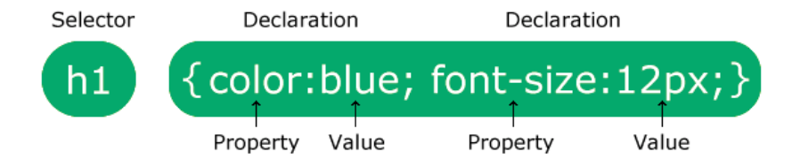
CSS Syntax:

Slide 23
Ways to add CSS to page
Inline CSS: The CSS is added to particular tab using the style attribute. Inside the opening tag of an element.
Eg. <h1 style="color:blue;text-align:center;">
Internal CSS : The CSS is written inside the <style> tag in the same page.
External CSS: The CSS is written in seperate file with .css extension and then that file is attached to our HTML document using <link> tag. Eg. <link rel="stylesheet" href="mystyle.css">

Slide 24
CSS selectors:
CSS selectors are used to target specific HTML elements for styling.
Common CSS selectors include:
Element selectors: Target specific HTML elements by their tag name (e.g., h1, p, div).
Class selectors: Target elements based on their class attribute (e.g., .header, .btn).
ID selectors: Target elements based on their unique ID attribute (e.g., #logo, #nav).
Attribute selectors: Target elements based on their attribute values (e.g., [type="text"], [href^="https://"]).

Slide 25
CSS Combinators
descendant selector (space) : matches all elements that are descendants of a specified element.
Eg. #demo p{}
child selector (>): The child selector selects all elements that are the children of a specified element. Eg. #demo>p{}
adjacent sibling selector (+): The adjacent sibling selector is used to select an element that is directly after another specific element. Eg. #demo+p{}
general sibling selector (~): The general sibling selector selects all elements that are next siblings of a specified element. Eg. #demo~p{}

Slide 26
CSS units:
There are two types of units in CSS.
Relative Units: Relative units are based on the size of other elements or the viewport, making them flexible and suitable for responsive design.
% (Percentage): Relative to the parent element's size or the containing block's size.
em (Relative to Font Size): Relative to the font size of the element itself. 1em=16px.
rem (Relative to Root Font Size): Relative to the font size of the root element (<html>).
Absolute Units: Absolute units are fixed-size units that do not change with respect to the screen or the parent element.
px (Pixels): The most commonly used unit. One pixel corresponds to a single dot on a screen.

Slide 27
CSS Colors
In CSS colors are specified by
Color name: red, pink
RGB value: rgb(255,0,0)
HEX value: #ffffff;

Slide 28
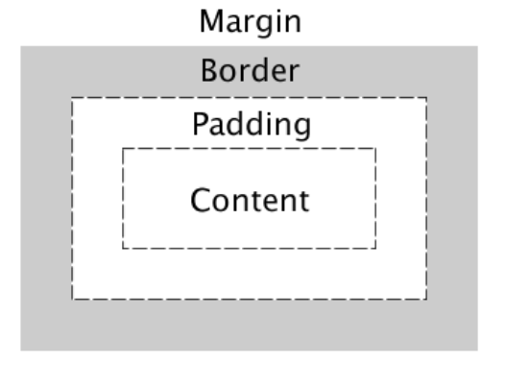
CSS Box Model:
The CSS box model is a fundamental concept in web design that describes how elements are rendered and displayed on a webpage. It consists of several components, including content, padding, border, and margin.

Slide 29
CSS Border
border-width: 3px;
border-color: black;
border-style: solid;

Slide 30
CSS Padding and margin:
Padding is the space between the content area and the element's border.
padding-top: 30px;
padding-left: 30px;
padding-bottom: 30px;
padding-right: 30px;
padding:30px 20px 10px 30px;
Margin is the space outside the border, creating space between elements. It controls the gap between an element and its neighboring elements.
margin: 30px;

Slide 31
Background Properties
background-color: #ffffff;
background-image: url(image.jpg);
background-repeat: no-repeat;
background-size: contain;

Slide 32
CSS Fonts
font-family: 'Gill Sans', 'Gill Sans MT', Calibri, 'Trebuchet MS', sans-serif;
font-size: 20px ;
font-style: italic;
font-weight: 600;

Slide 33
CSS Text
color:pink;
text-align:center;
text-transform: uppercase;
letter-spacing: 5px;

Slide 34
CSS Positioning:
CSS positioning allows you to control the placement and layout of elements on a webpage. It provides different positioning options that can be used to create complex and responsive designs.
Absolute Positioning:
Absolute positioning removes the element from the normal document flow and positions it relative to its closest positioned ancestor. However; if an absolute positioned element has no positioned ancestors, it uses the document body, and moves along with page scrolling.
Relative Positioning:
Relative positioning allows you to move an element relative to its normal position within the document flow. It retains its space in the layout, and other elements are not affected by its movement

Slide 35
Fixed Positioning:
Fixed positioning is similar to absolute positioning but is always positioned relative to the browser window, even if the page is scrolled. The element remains fixed in its position regardless of scrolling.
Static Positioning:
By default, elements are positioned statically, following their normal flow within the document. They are not affected by positioning properties like top, bottom, left, or right. This is the default behavior and does not require any specific CSS.
Sticky Positioning:
Sticky positioning is a combination of relative and fixed positioning. It allows an element to be positioned relative to its normal position until a certain scroll threshold is reached, after which it becomes fixed.

